Slide 1


Enhancing bioinformatics capacity within the United States Fish and Wildlife Service through university partnership
Aaron Maloy¹, Istvan Albert², Aswathy Sebastian²,
Natay Berhanu Aberra², Christopher Rees¹, Meredith Bartron¹
¹ United States Fish and Wildlife Service, Northeast Fishery Center, Lamar, PA 16823
² Pennsylvania State University, Department of Biochemistry and Molecular Biology, University Park, PA 16802

Slide 2

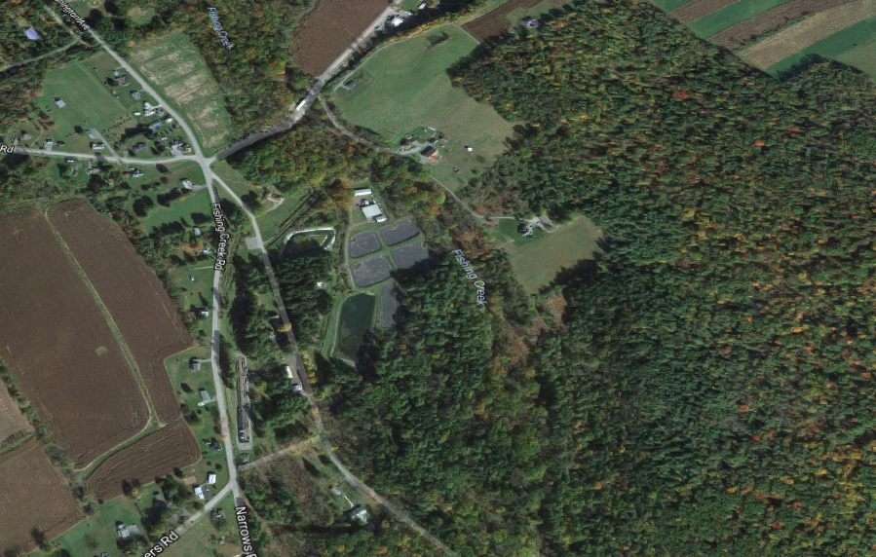
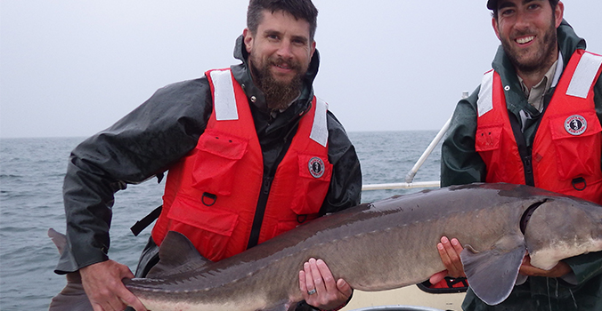

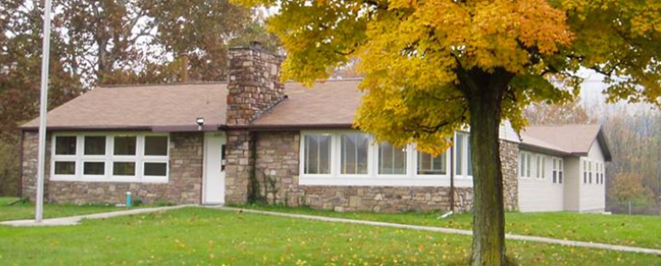
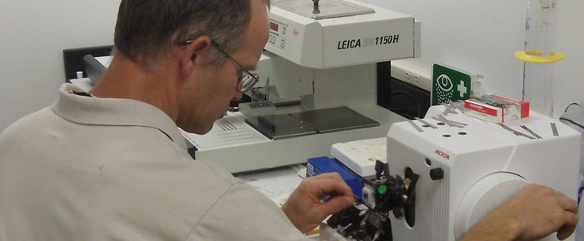
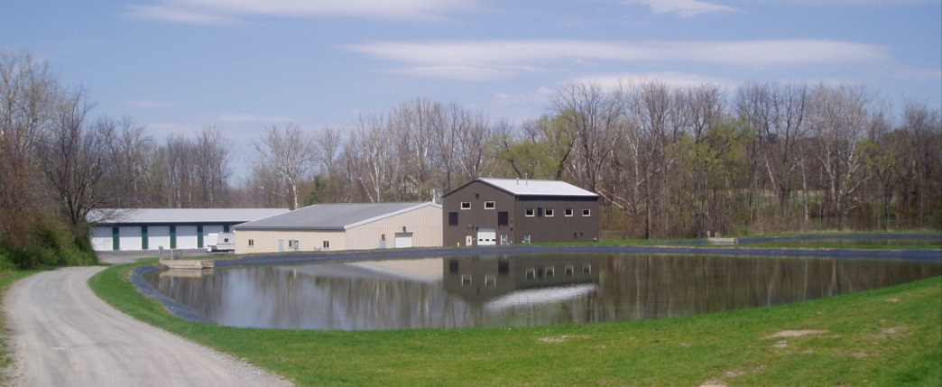
The Northeast Fishery Center (NEFC)
Lamar, Pennsylvania
Population Dynamics
Hatchery Operations & Research
Fish Health Unit
Public Outreach
Conservation Genetics Laboratory
Center Director: Dr. Mike Millard
Fish Technology Chief: Dr. Meredith Bartron

Slide 3
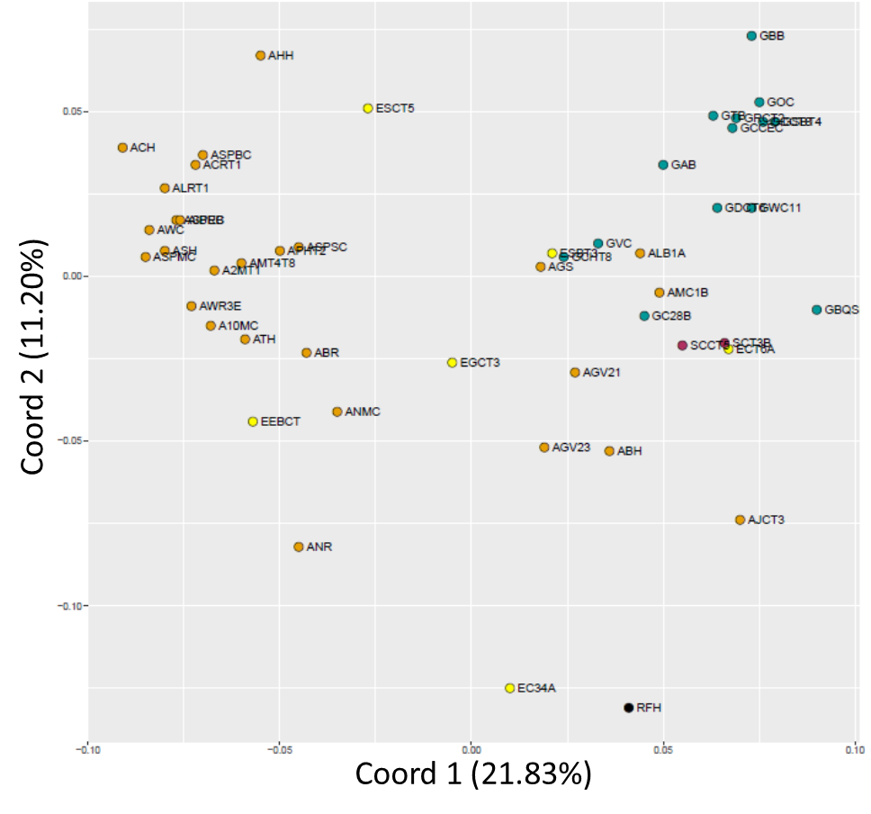
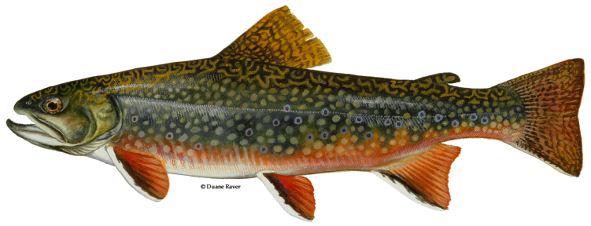
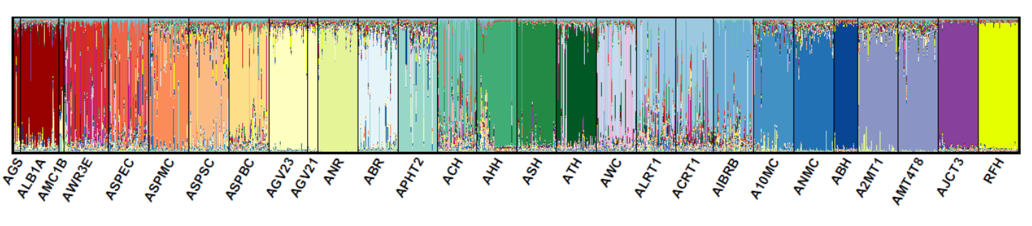
Conservation Genetics Lab at the NEFC
Population Genetics (microsatellite analysis)
Broodstock management
  Atlantic Salmon
  Pallid Sturgeon
Assess population structure
  Brook Trout
  Lake Sturgeon
Allegheny
Genesee
Susquehanna
Population structure of book trout in western New York

Slide 4
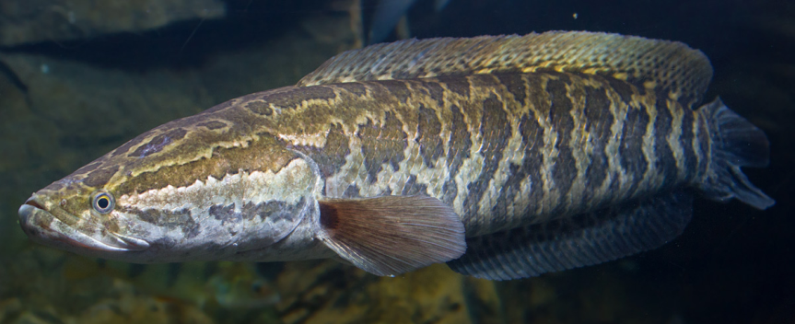
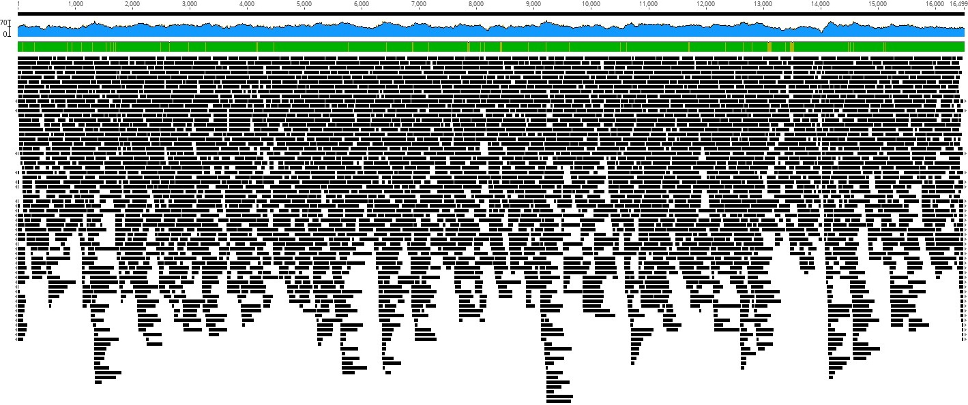
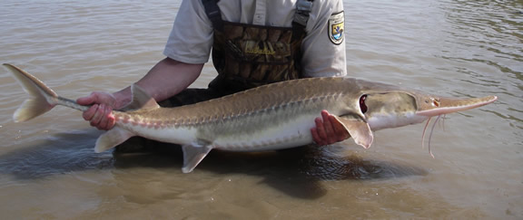
Conservation Genetics Lab at the NEFC
Molecular Ecology (qPCR and NGS)
Early detection of invasive species
  - Round Goby
  - Northern Snakehead
Detection of T & E or rare species
  - Dwarf Wedge Mussel
  - American Eel
Mitochondrial genome
sequencing
Biodiversity monitoring using
environmental DNA
Northern Snakehead
Pallid Sturgeon
Mitochondrial genome assembly of Pallid Sturgeon

Slide 5
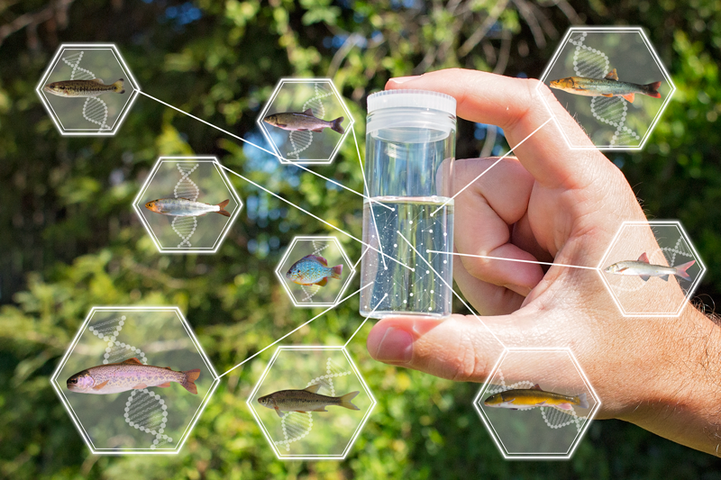
Biodiversity monitoring with environmental DNA
DNA metabarcoding
From FishBio: March 23, 2015

Slide 6
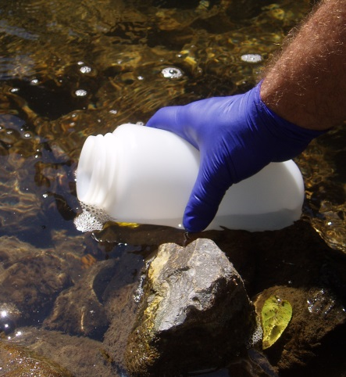
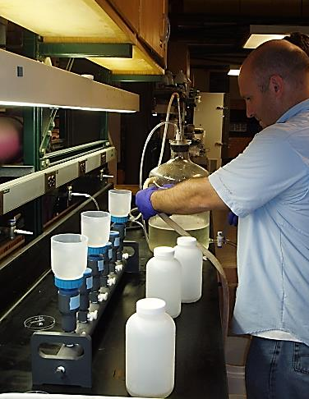
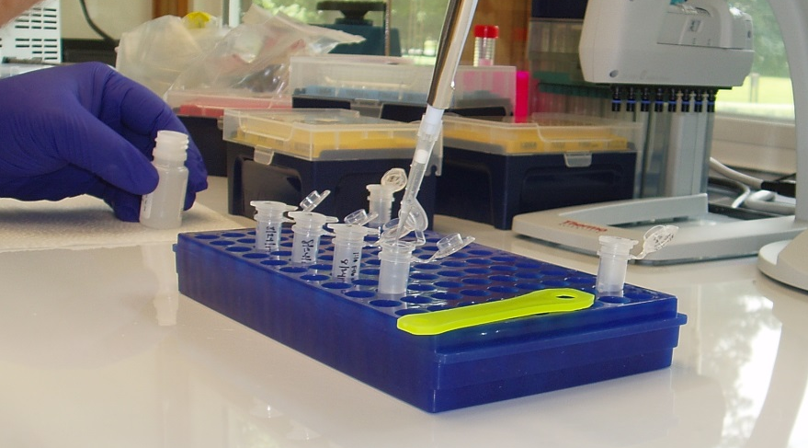
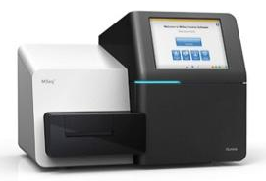
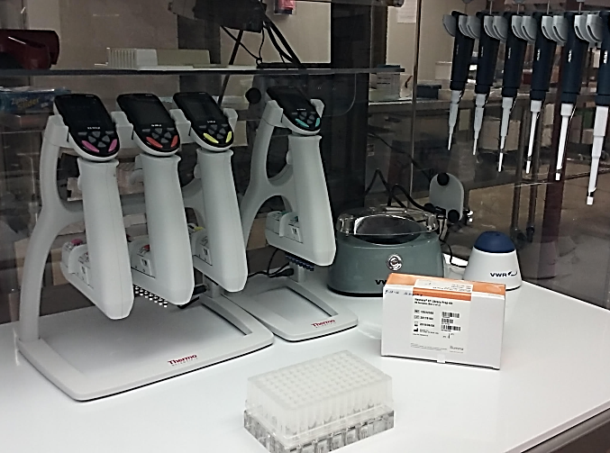
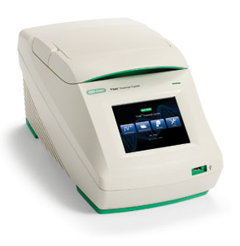
eDNA water sample to DNA sequences
Water sample
Water filtration
DNA extraction
Sequencing PCR products
Library preparation
PCR amplification

Slide 7
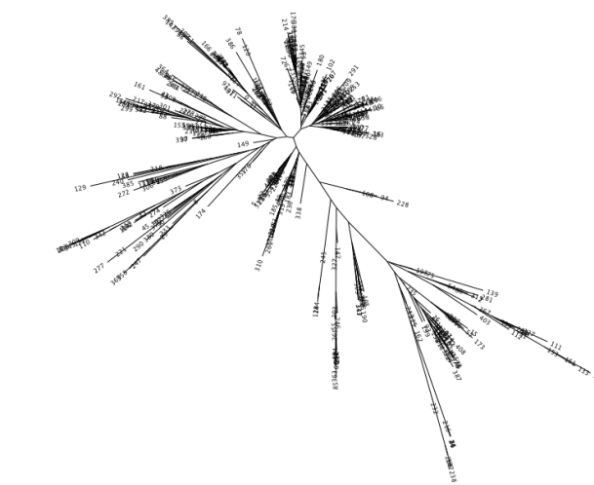
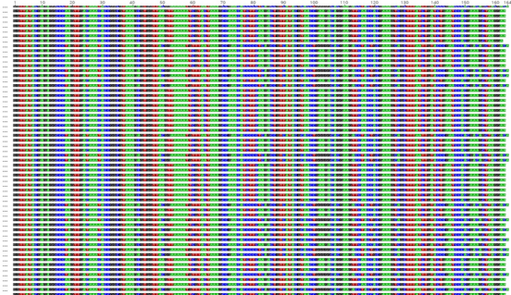
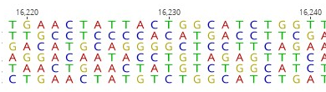
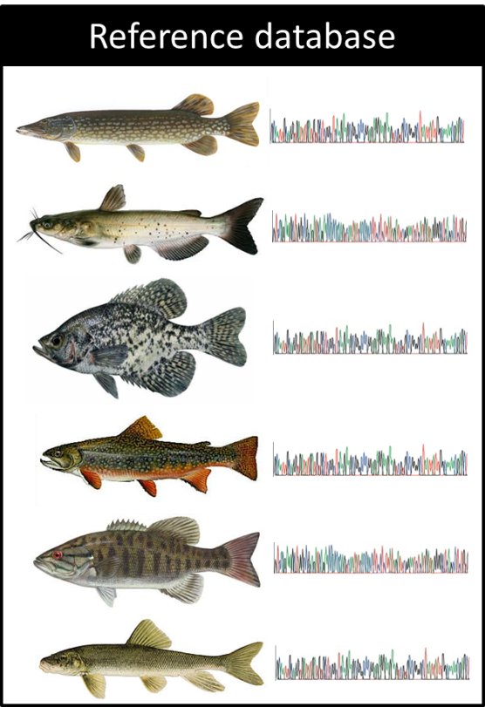
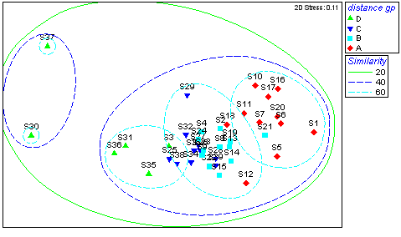
Metabarcoding workflow: Bioinformatics
Illumina sequence reads
Sort by index
Merge reads
Quality trim
Size select
Error correction
Remove chimeras
25 Million Sequences!
OTU clustering
ID clusters or reads
Relevant statistical analysis
Data matrix of taxonomic identifications

Slide 8

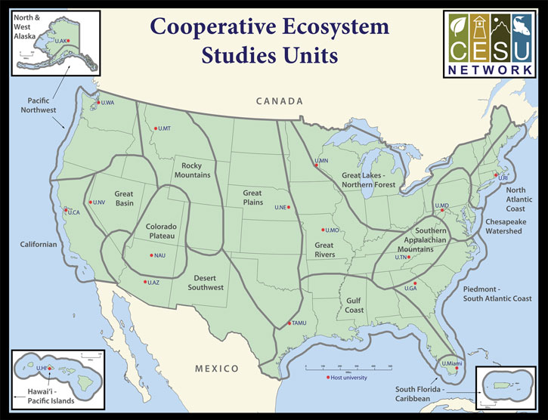

Developing bioinformatics capacity within the US Fish and Wildlife Service
Dr. Istvan Albert
Professor of Bioinformatics
Finalized a CESU agreement to collaboratively develop bioinformatics solutions for USFWS metabarcoding projects
August 2016 through August 2019

Slide 9

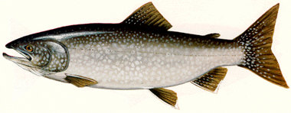
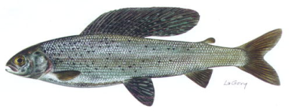
CESU project goals
Computational resources to process data
Develop bioinformatics pipeline that utilize best available science
Produce data output that can be easily used in downstream statistical analyses
Package these capabilities in a format that is accessible and usable
Accessible from a Windows environment
Peer review publication of bioinformatics interface and pipeline
- Amazon Cloud Services
- Aswathy Sebastian – Computational Scientist
- Aswathy Sebastian
- Natay Berhanu Aberra – Programmer (CESU supported)
- Natay Berhanu Aberra

Slide 10
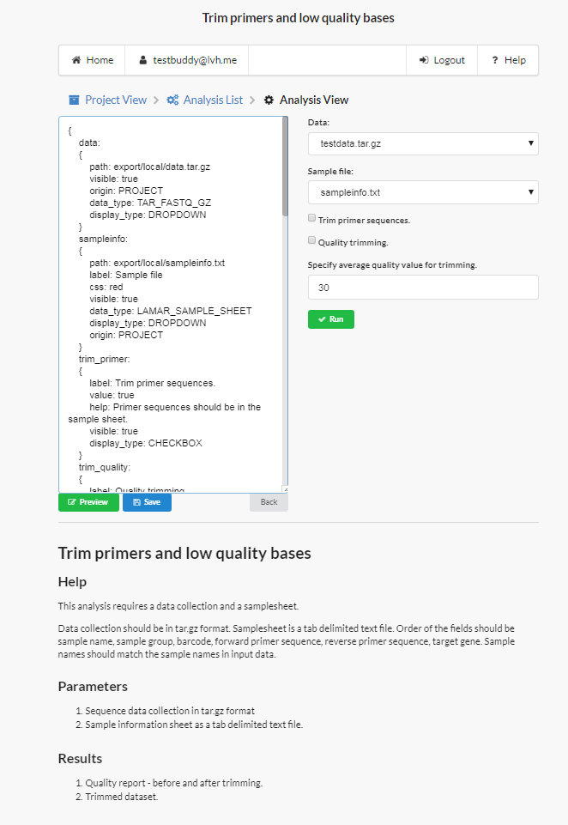
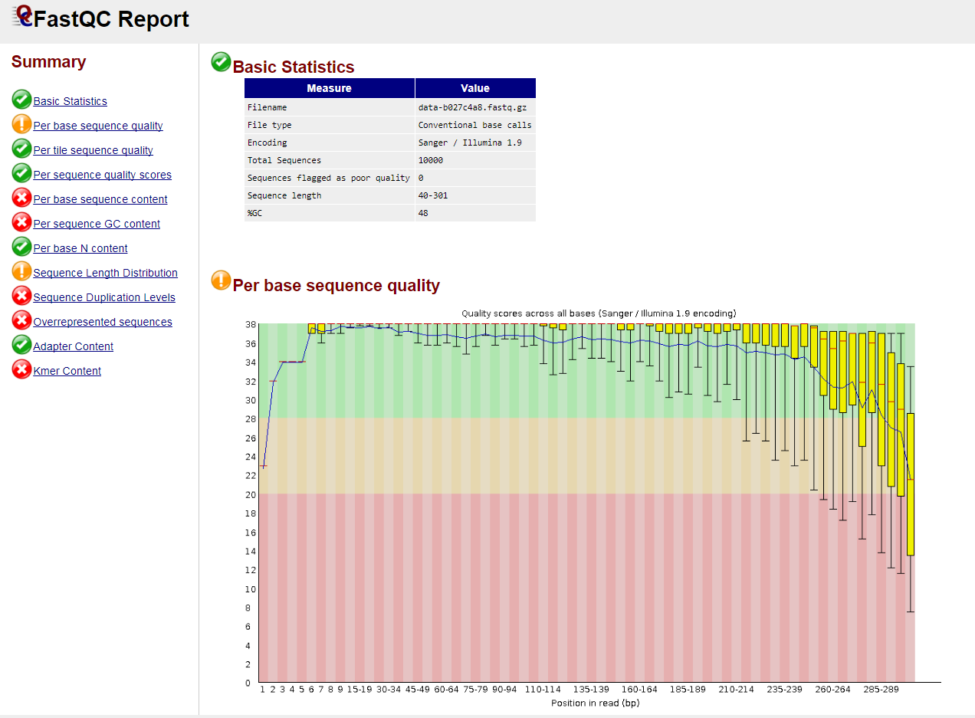
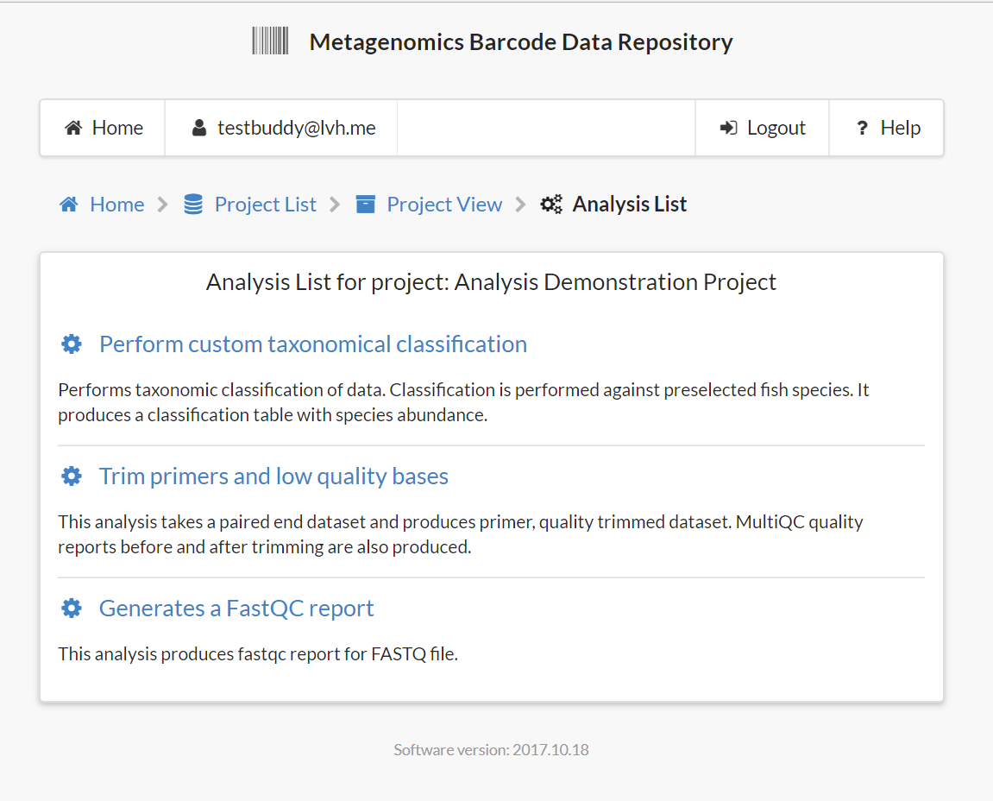
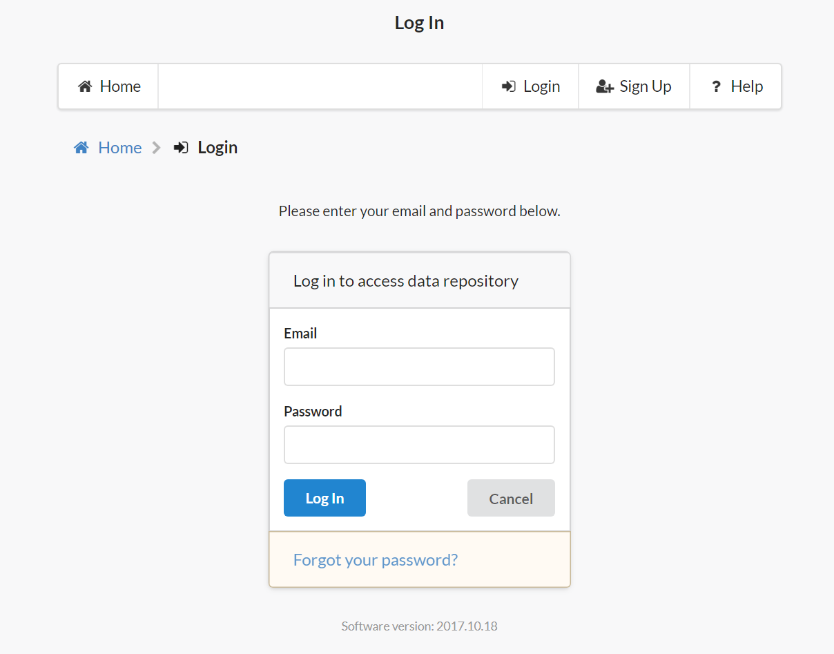
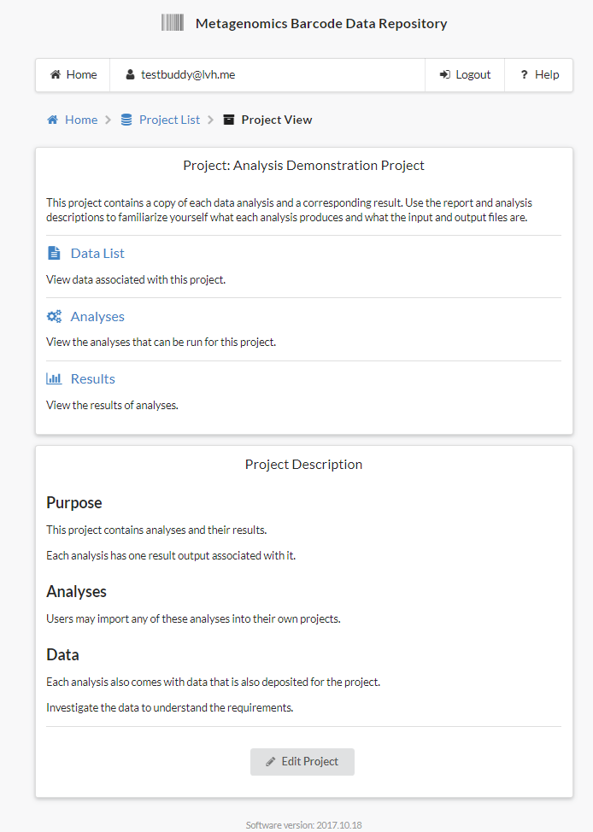
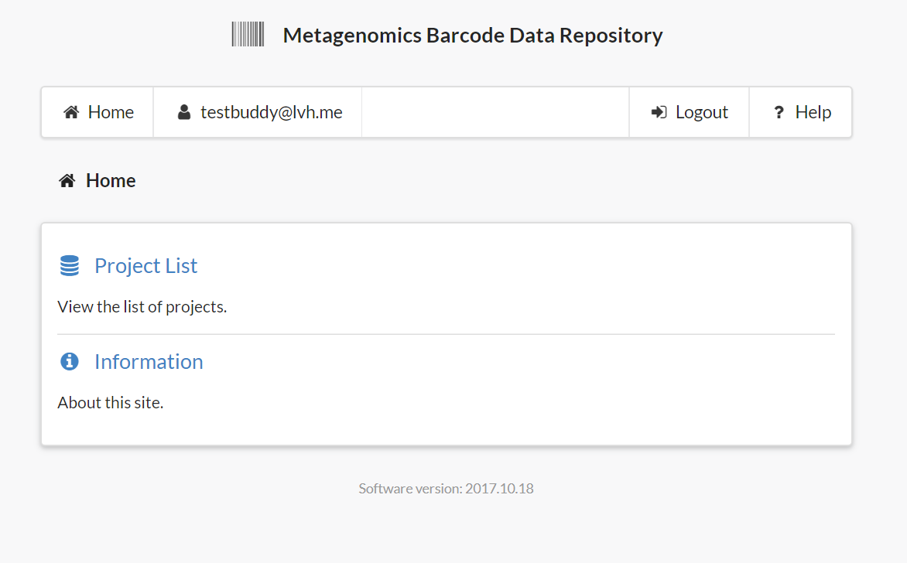
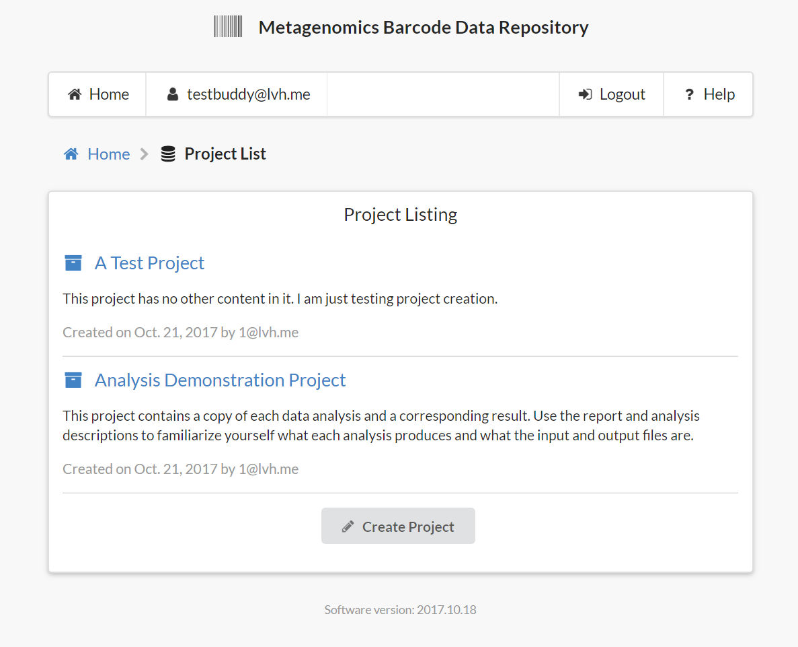
https://www.metabarcode.com/

Slide 11
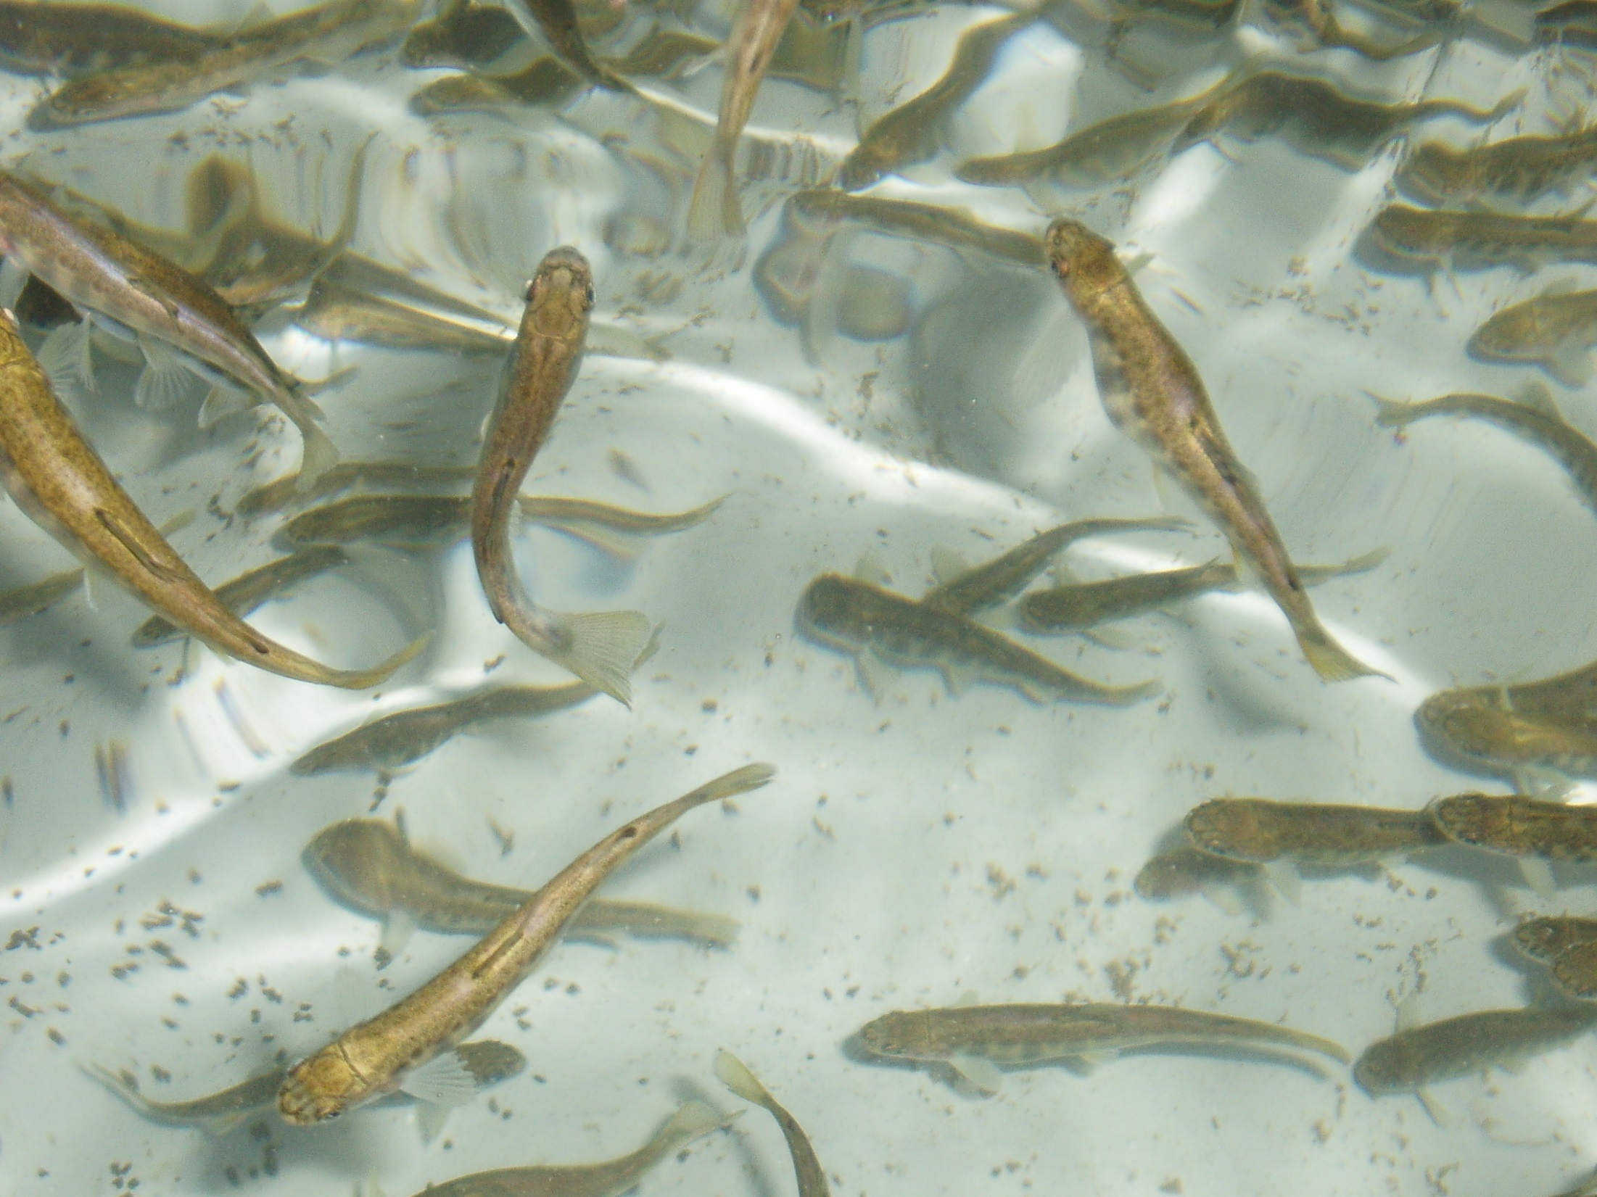
Thank You

