Slide 1
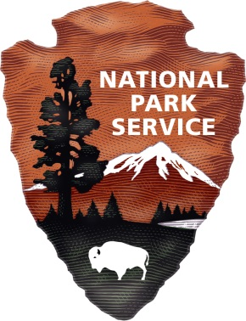
Natural Resources Internships for Undergraduate and Graduate Students
Tim Watkins, PhD
Science Access & Engagement Coordinator

Slide 2

Geoscientists in the Parks (GIP)
Students and grads, age 18-35
3-12 months
Apply Dec 1 – Jan 31
go.nps.gov/gip

Slide 3
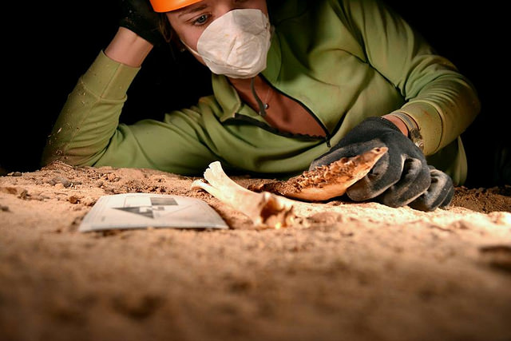
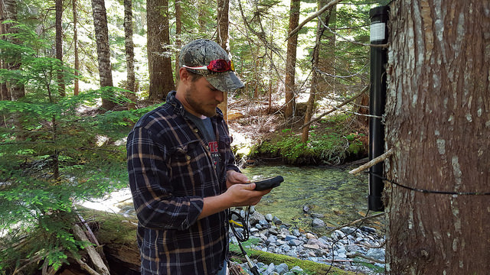
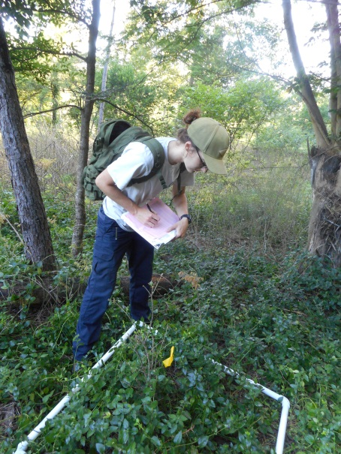
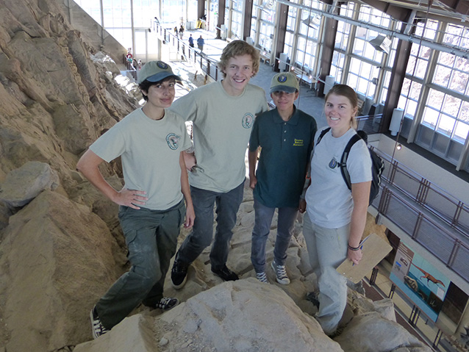
Hydrological monitoring, Mt Rainier
Archeology and paleontology, Grand Canyon
Invasive plant monitoring, Hot Springs
Mapping for virtual quarry, Dinosaur

Slide 4
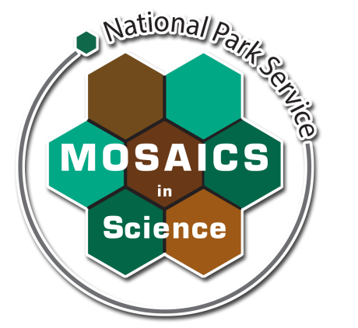
Mosaics in Science (MIS)
Students and grads, age 18-35
Diverse groups under-represented in STEM
11 weeks + career workshop
Apply Dec 1 – Jan 31
go.nps.gov/mosaics

Slide 5
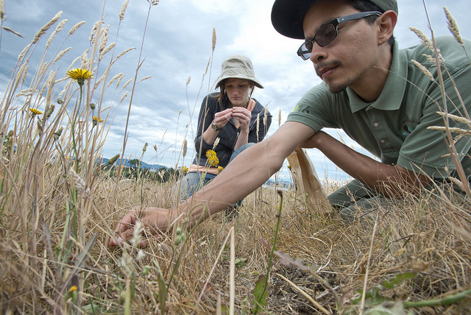
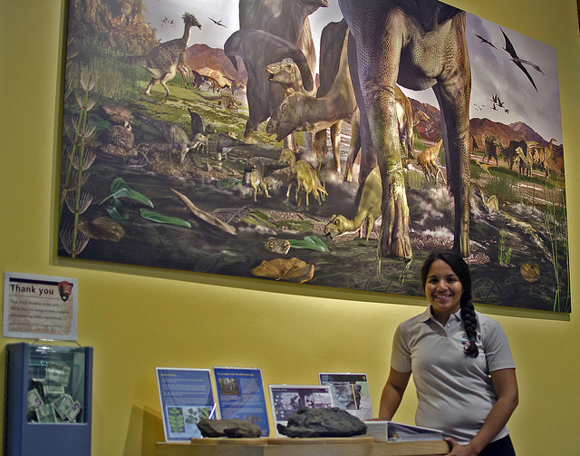
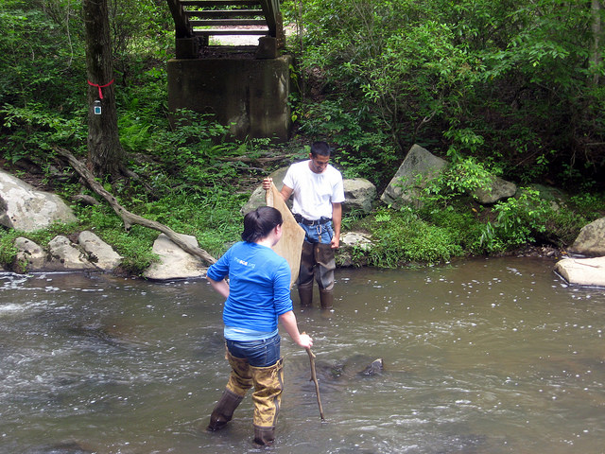
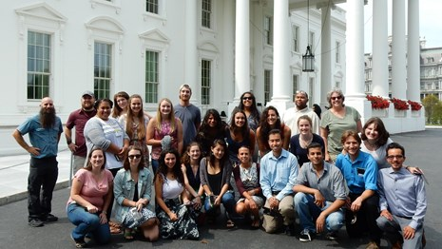
Prairie restoration, San Juan Island
Digital science communication, Denali
Stream health, Prince William Forest
Career workshop, Washington DC

Slide 6

Future Park Leaders of Emerging Change (FPL)
Enrolled UG/G students and new graduates
12 weeks + career workshop
Impacts of global change
Direct Hire Authority
Apply Dec 5 – Jan 26
futureparkleaders.org

Slide 7
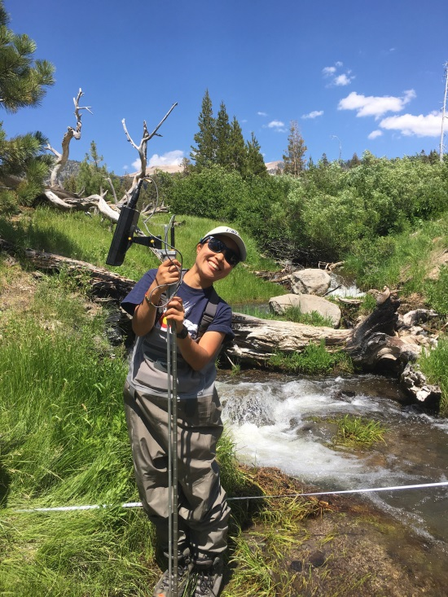
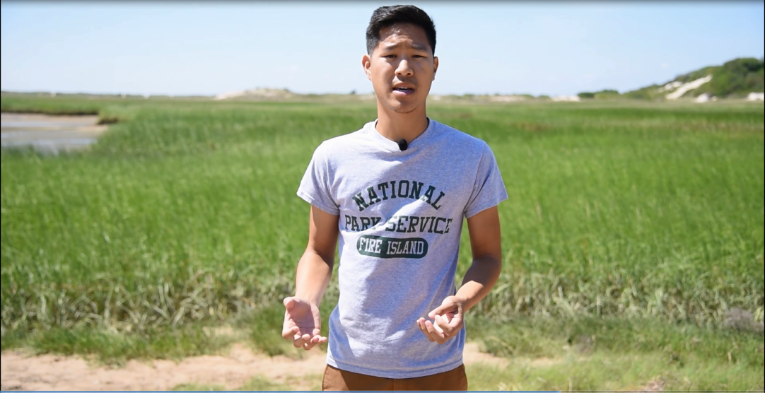
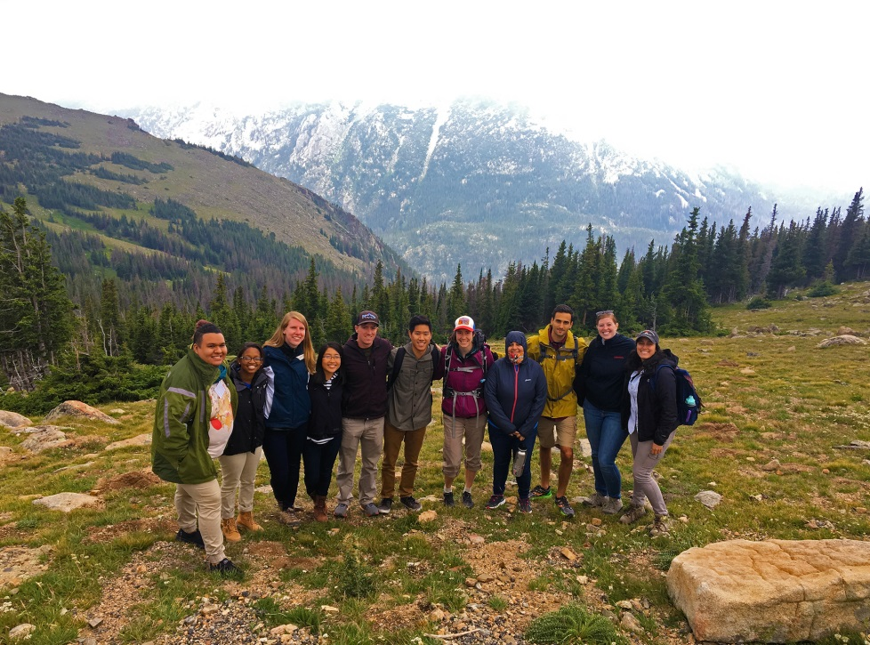
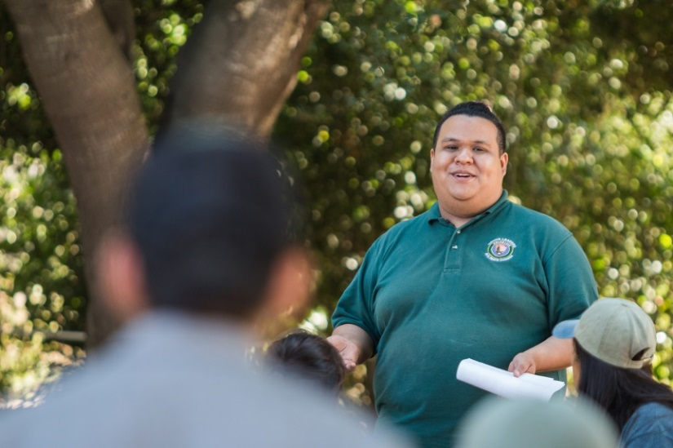
Post-Sandy scicomm, Fire Island
Cold air pools, Devil’s Postpile
Climate change outreach, Santa Monica Mountains
Group workshop, Rocky Mtn

