Slide 1

CHWA CESU Improvements
Katie Kline
kkline@umces.edu
Notes:
I’ll be presenting progress we’ve been making related to addressing the objectives/goals that were established during the development of the Strategic Plan last year.
Initiatives related to supplemental NPS funding: NPS Fellowship Program, Linking Projects Database to Experts Database Expert Profiles, website redesign.

Slide 2

Strategic Plan Goals
Facilitate the collaborative ideal of the CESU Network
Promote and foster strategic growth
Improve justice, equity, diversity, and inclusion
Prioritize student engagement
https://chwacesu.org/chesapeake-watershed-cesu-strategic-plan-2021/
Notes:
Review goals developed in Strategic Plan

Slide 3
NPS Fellowship Program
Help prioritize student engagement
Two Activities
  Student Fellowships
  Virtual Student Research Symposium
Engage underserved populations and tribal communities
Support work related to climate change
Additional federal partner engagement
Notes:
SP Poll: PI’s want to involve students, but that funding would often get dropped from the budget (limiting factor) – help prioritize student engagement.
We submitted a proposal for supplemental funding to support this initiative and it has been funded and is in the final processing phase.
Fellowship program: student fellowships and virtual Student Research Symposium (culmination of Fellowship program)
We will be trying to engage underserved populations/institutions, including tribal communities.
We’d like to see this program grow to include projects funded by other federal partners, but we would need support for that.

Slide 4
NPS Fellowships
NPS-funded projects (CHWA CESU)
Six annual fellowships ($3K each)
  Two years
  Three per year
Priority for members of underrepresented individuals and institutions
Priority for projects involving climate change or diversity focus
Notes:
These fellowships will be available to PI’s working on NPS-funded projects through the CHWA CESU.
We will be offering six annual fellowships – three per year over two years. They will be disbursed to the PI’s institution to disburse to their student fellow – part-time throughout the school year, full-time summer program, or however else they’d like to support their student’s time.
We will prioritize underrepresented individuals and institutions.
We will also prioritize projects involving climate change or those with a diversity focus.

Slide 5
Virtual Student Research Symposium
Year 3
Professional development for fellowship recipients and other students involved with CHWA CESU-funded work
Notes:
Culmination of the fellowship program.
We would also like to engage/solicit participation from other students performing research/work on any CESU-funded project.

Slide 6
Year One
Establish fellowship criteria, application requirements, and application deadline
Develop application evaluation rubric
Advertise/promote
Establish a review committee (Volunteers?)
Make Awards
Exit interviews with recipients at year-end
Assess and make adjustments for year two
Notes:
Specific tasks/goals for year one – beginning in the Fall semester 2023

Slide 7
Year Two
Advertising
Re-establish review committee
Make Awards
Exit interviews with recipients at year-end
Notes:
Poll: PI’s want to involve students but that funding would often get dropped from the budget
Virtual Student Research Symposium culmination of Fellowship program

Slide 8
Year Three
Virtual Student Research Symposium
Notes:
Will be held sometime during year 3 – fall semester best?

Slide 9

Experts Database
Embedded live view from Projects Database for Expert Profiles
https://chwacesu.org/experts_database/

Slide 10
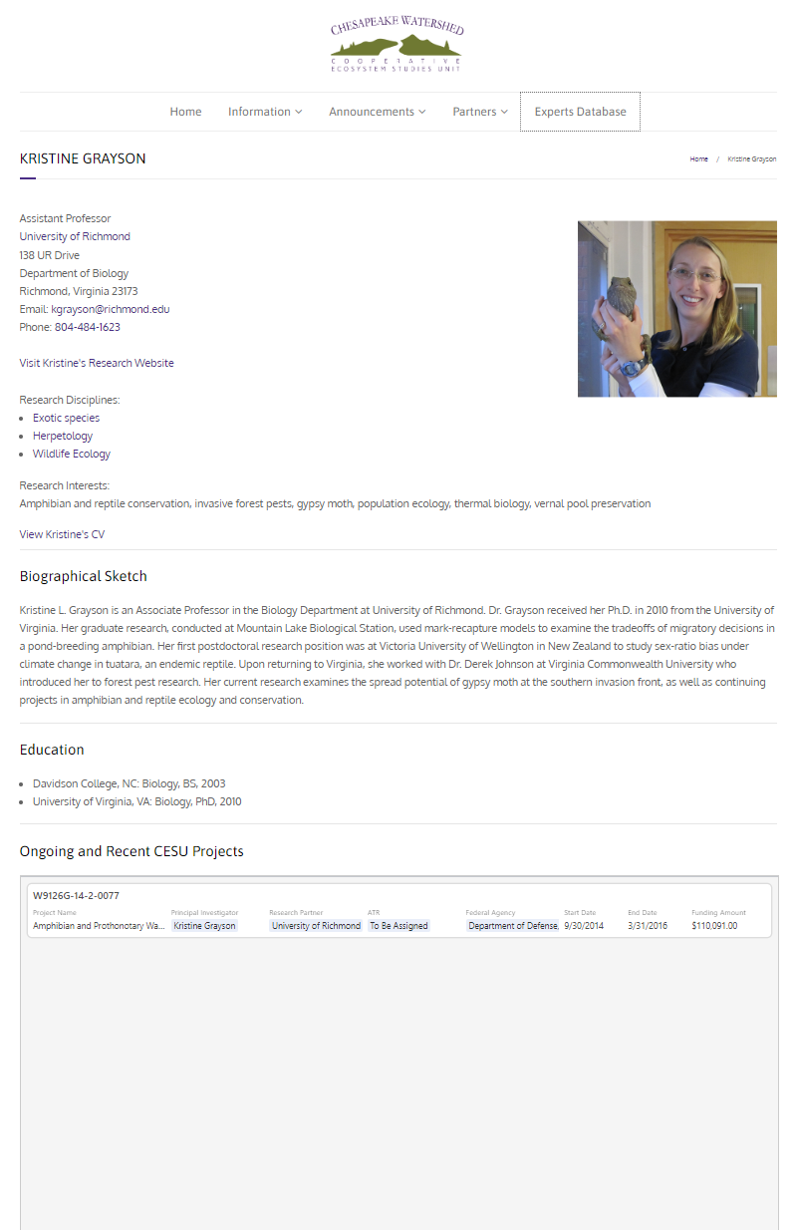
Notes:
Updates get made in realtime; no need for experts to add their CESU projects

Slide 11
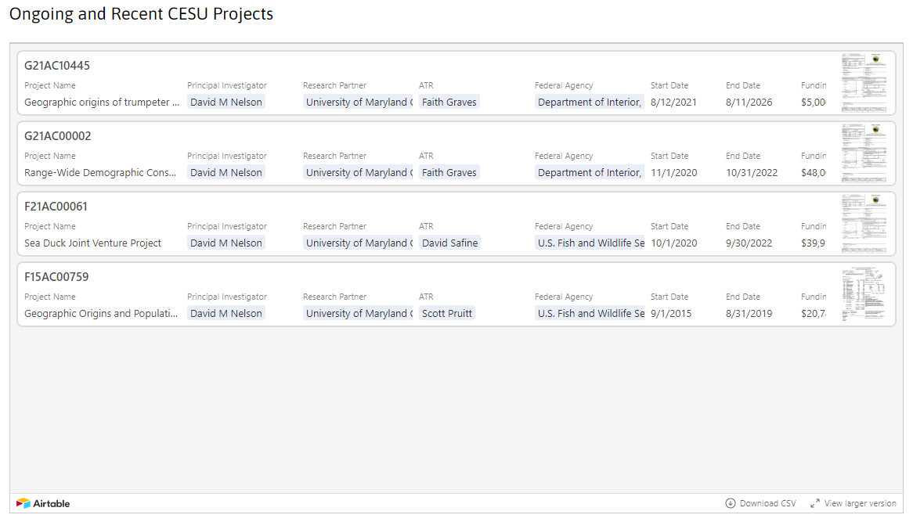
CESU Projects
Notes:
Updates get made in realtime; no need to experts to add their CESU projects

Slide 12
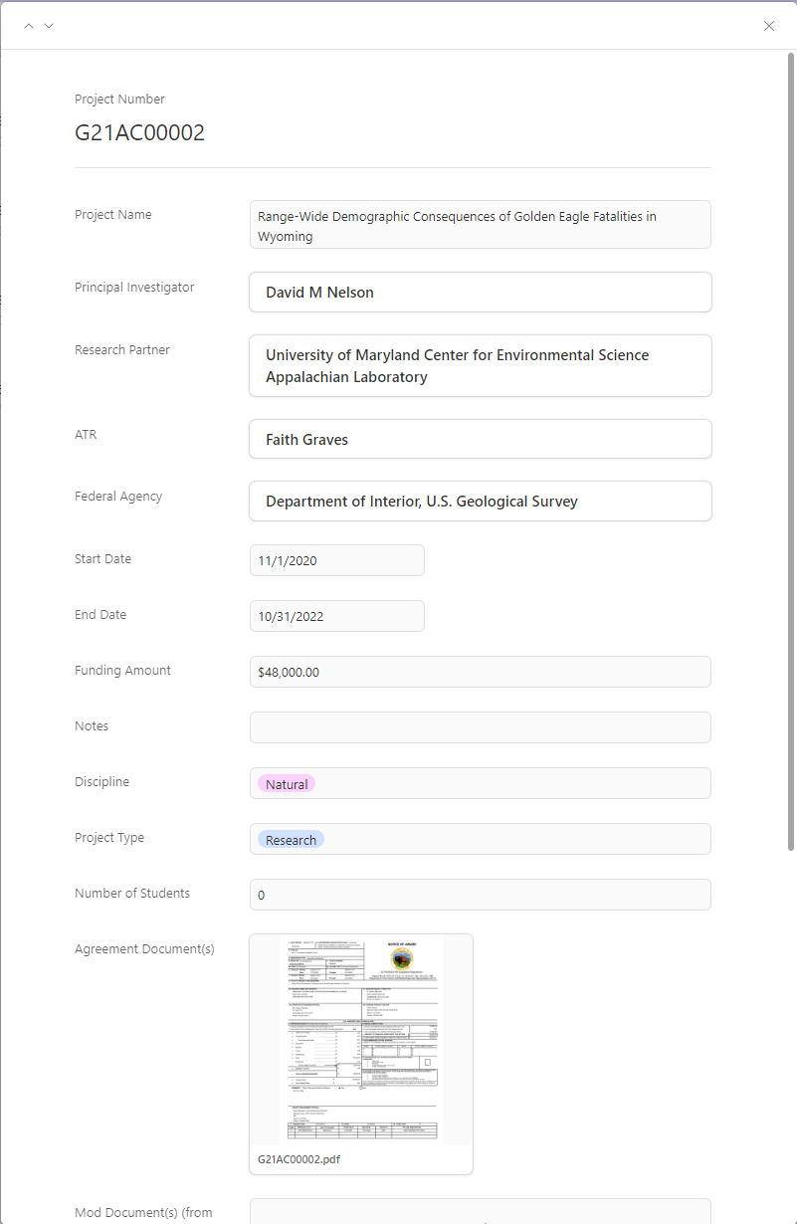
Individual Projects

Slide 13
Logo Update

Slide 14
Current Logo
Notes:
Variation on original – developed circa 2015

Slide 15




Other CESU Logos

Slide 16

Updated Logo
Notes:
Iterative process – tried both 6 and 8 letter options – 8 letters was too wide – looked cumbersome
We chose one icon that represented more “natural”/scientific activities (river) and one icon related more to historical/cultural activities (museum)
This is what we arrived with:
We decided to stick with the purple and added gray as the second color (it is neutral and complimentary to the other colors from the CESU Network logo).
Any feedback, concerns, or suggestions?

Slide 17
Website Redesign
Improved responsiveness
Improved navigation – easier to find content
Dynamic content – easier to feature content (projects, inititiaves)
Fresh/modern design
“Calls to Action”
Notes:
We set some goals to help make the website more functional and also to make updating content easier on our end.
Dynamic content – enter it once and it changes sitewide (partners, experts)

Slide 18
Home
About
How To
Opportunities^
What’s New*
Projects^
Experts^
Join the CW CESU
Funding Opportunities⁺
Project Spotlights
Meet the Team
Post an Announcement
Employment Opportunities
Newsletter Articles
CW CESU Meetings
FAQ
Contact Us
Student Opportunities
Other Announcements
CW CESU Partners
Launch a Project
Awards
Fed Partners^
Fellowships
GrantSolutions
Internships
Non-Fed Partners^
Renewal Info
Strategic Planning
CESU National Network
*Categorized Posts
^Dynamic Custom Content Type
⁺Include ability to tag/label as CESU-related vs. open funding opportunities
Notes:
Goal: Organize the navigation better (more deliberate process); make it easier to find things in a click or two

Slide 19
Site Mock Ups

Slide 20
NPS Fellowship Update
Expected to be awarded in the next two weeks; will launch in FY 2024
Effort to meet goals three and four of the Strategic Plan
Inspire other Federal Agencies to consider similar programs
Newsletter coming in July – More on this program, website improvements, Student Awards, Strategic Plan efforts, etc.

